Slide 1
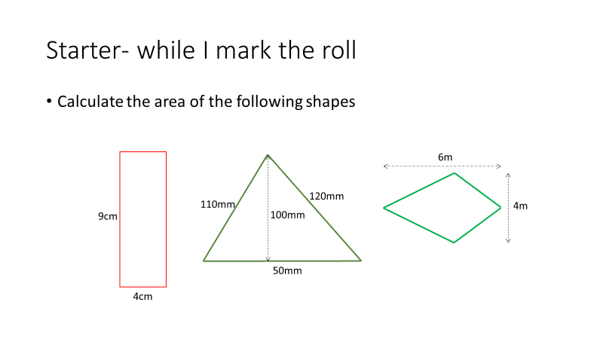
Notes:
hook

Slide 2
24
7
30
Date
Total Surface Area
EQ – How do you calculate the total surface area of a 3D object
5
Notes:
Lesson objective (EQ)

Slide 3
Lesson objective
By the end of this lesson you will be able to;
- Calculate the Total Surface Area of a 3D object
Notes:
Lesson

Slide 4
Success Criteria
You will know you are successful in achieving the objective by…
Being able to calculate the Total Suface Area of an object

Slide 5
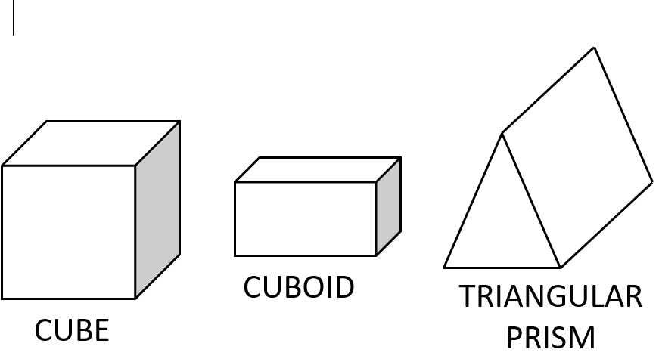
24
7
30
Date
Surface Area
EQ – How do I calculate the surface area of a 3D object
A prism is a 3D shape that has a constant cross-section.
Total Surface Area (TSA) is the sum of the areas for each face of the 3D object
5
Notes:
Input

Slide 6
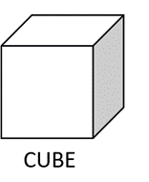
24
7
30
Date
Total Surface Area
EQ – How do you calculate the total surface area of a 3D object
For each 3D shape you need to break it down.
For example a Cube
a cube has 6 faces
Front/back
Top/Bottom
Left/Right
You need to calculate the area for each face then add the 6 area’s together to get the Total Surface Area (TSA)
Rectangular Prisms also have 6 faces
5
Notes:
Lesson objective (EQ)

Slide 7
2.1: TSA of a rectangular prism or cube
6m
7m
8m

Slide 8
Cut the box up into its 6 faces
8m
Front & Back.
6m
2 of these, so SA
= 2 × 8 × 6 = 96 m²
8m
Top & Bottom.
7m
2 of these, so SA
= 2 × 8 × 7 = 112 m²
7m
Left & right.
6m
2 of these, so SA
= 2 × 6 × 7 = 84m²
TSA = 96 + 112 + 84 = 292m²

Slide 9
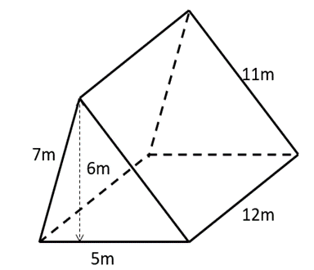
24
7
30
Date
Total Surface Area
EQ – How do you calculate the total surface area of a 3D object
A triangular prism has 5 faces
Front/back which are triangles
3 sides that are rectangles.
With some prisms using ‘shape nets’ can make it easier to identify the dimensions of each of the faces, triangular prisms are one of these shapes.
5
Notes:
Lesson objective (EQ)

Slide 10
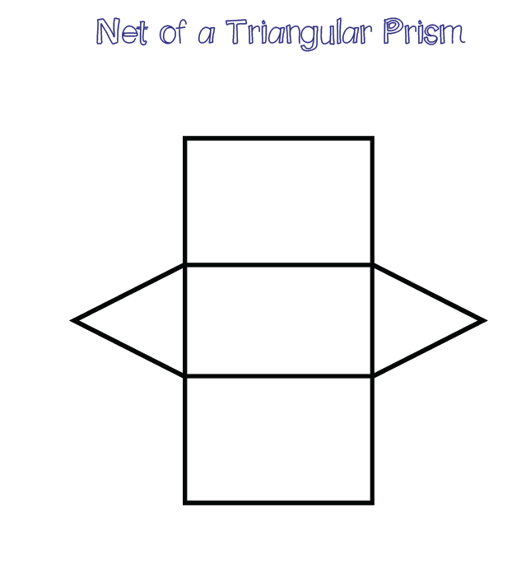
24
7
30
Date
Total Surface Area
EQ – How do you calculate the total surface area of a 3D object
Shape net of a Triangular prism
Clearly shows the areas that need calculating
Once drawn transfer the measurements and then calculate your areas.
5
Notes:
From the previous slide write the measurements onto the net so the students can see how to transfer the measurements.

Slide 11
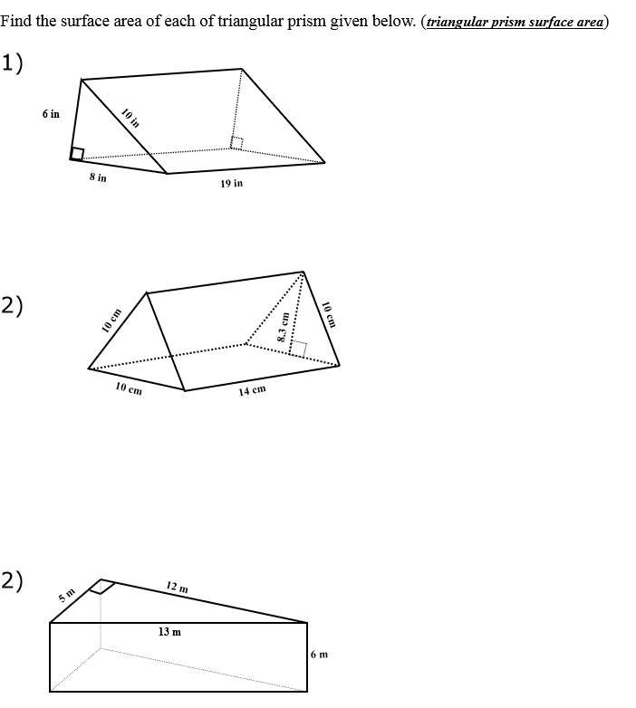
Activity
Notes:
Independent practice

Slide 12
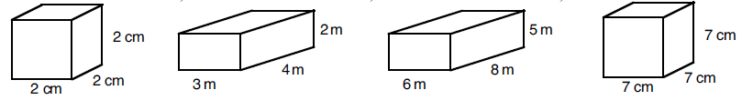
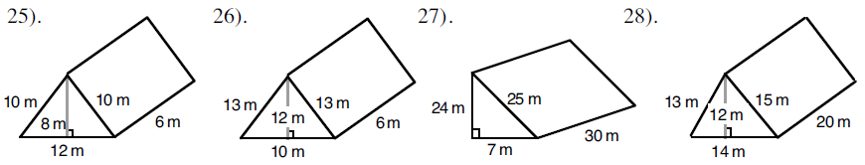
1.
2.
3.
4.
5.
6.
7.
8.
9. Katy wants to wrap a present that is 15cm wide, 18cm deep and 4cm high. How much wrapping paper will she need to use?
10. A length of copper piping is in the shape of a triangular prism. The triangle on it’s end is 9mm tall, 4mm wide. The piece of pipe is 18cm long. What is the surface area of the pipe?
11. A box has no lid. The box measures 1.2m by 30cm by 45cm. What is the surface area of the outside of the box?

Slide 13
Surface Area of Prisms
Area of Parallelograms
= 9 x 7
= 63cm²
Area of Rectangles 1
= 11 x 9
= 99cm²
99 x 2
= 198cm²
Area of Rectangles 2
= 8 x 11
= 88cm²
88 x 2
= 176cm²
TOTAL SURFACE AREA
= 63 + 198 + 176
= 437cm²
7cm
8cm
11cm
9cm

Slide 14
Surface Area of Prisms
6cm
TOTAL SURFACE AREA = 56 + 128 + 160 + 128 + 96
= 568cm²
8cm
7cm
8cm
16cm
Area of Trapeziums = ½ (10 + 6) x 7
= ½ x 16 x 7
= 56cm²
10cm
Area of Rectangle 1 = 16 x 8
= 128cm²
Area of Rectangle 2 = 10 x 16
= 160cm²
Area of Rectangle 3 = 16 x 8
= 128cm²
Area of Rectangle 4 = 6 x 16
= 96cm²

Slide 15
Find the surface area of the following shapes
6m
4cm
5m
4m
3cm
7cm
9m
5m
7cm
8cm
11cm
9cm

Slide 16
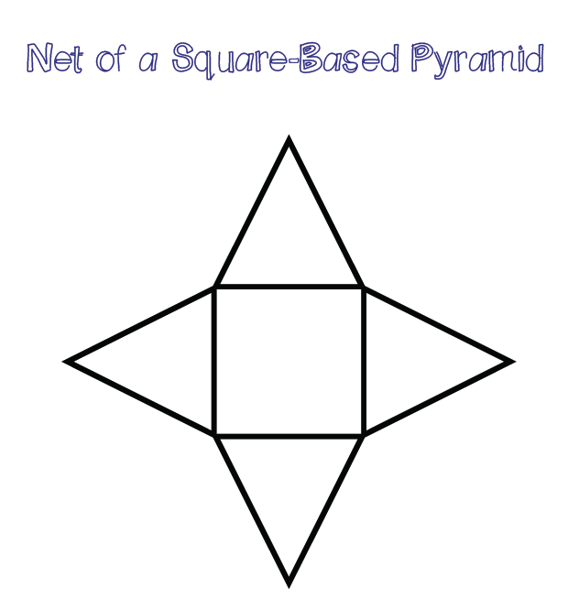
24
7
30
Date
Total Surface Area (TSA)
EQ – How do you calculate the total surface area of a 3D object
Shape nets are good for calculating the surface area of composite shaped prism and pyramids.
Once you have flattened the 3D shape you can see what needs to be calculated.
The pyramid pictured needs the area of 4 triangles and 1 square added together to find TSA
5
Notes:
Lesson objective (EQ)

Slide 17
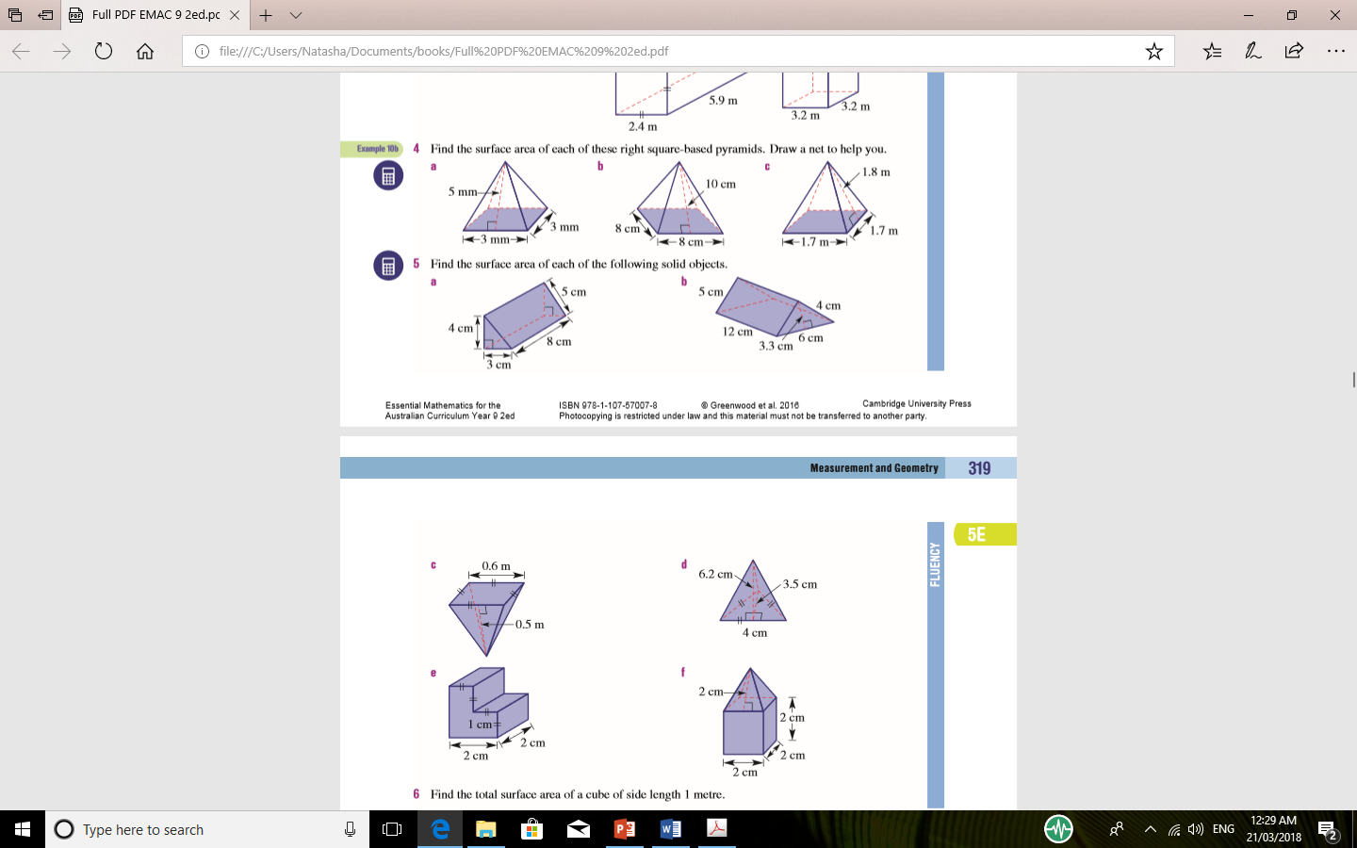
Activity
Notes:
Independent practice

Slide 18
Activity
Notes:
Independent practice

